Slide 1
JAVA Lecture 18
Autoboxing & Unboxing
in JAVA

Slide 2
What is Autoboxing and Unboxing?
Autoboxing: Automatic conversion of primitive types to wrapper objects.
Example: int → Integer
Unboxing: Automatic conversion of wrapper objects to primitive types.
Example: Integer → int
✅ Introduced in Java 5 to simplify code.
✅ Useful in collections, generics, and method arguments.

Slide 3
Wrapper Classes in Java
Primitive Type | Wrapper Class
byte | Byte
short | Short
int | Integer
long | Long
float | Float
double | Double
char | Character
boolean | Boolean
✅ Wrapper classes are immutable and belong to java.lang package.

Slide 4
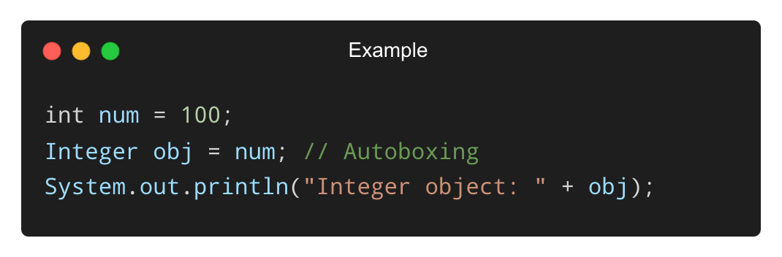
Example of Autoboxing
Primitive to object (automatically):
✅ No need to call Integer.valueOf(num) manually.

Slide 5
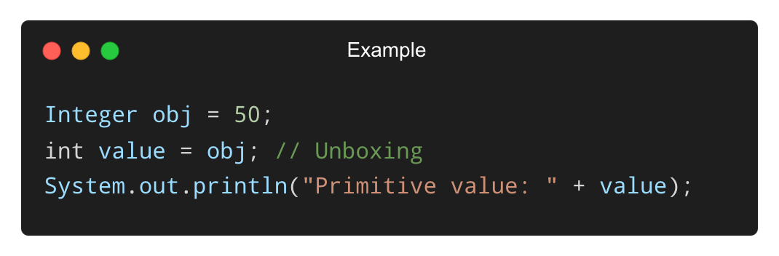
Example of Unboxing
Object to primitive (automatically):
✅ No need to call obj.intValue() manually.

Slide 6
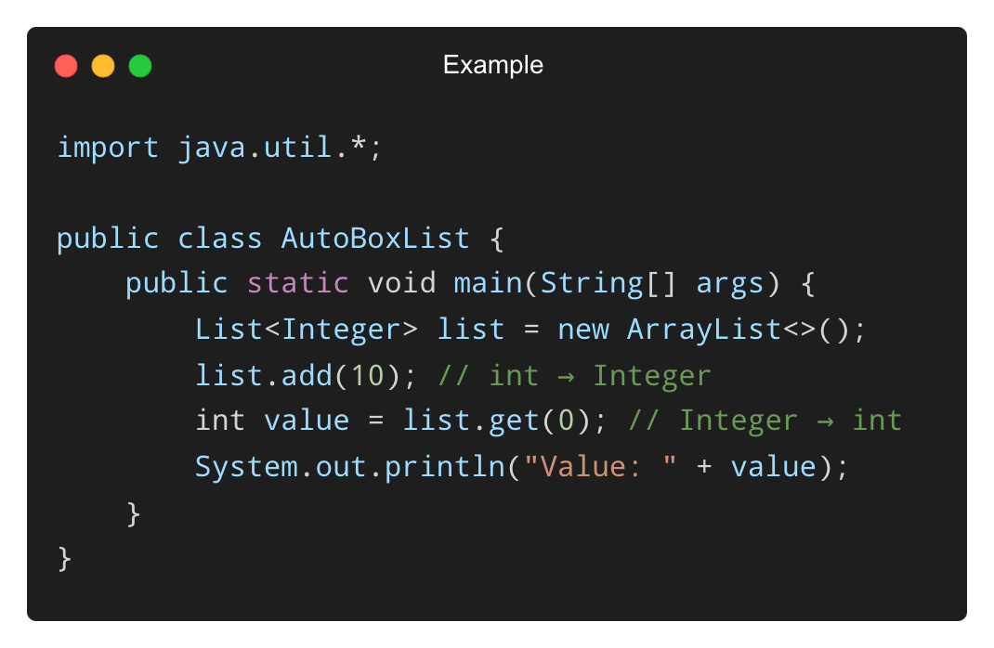
Autoboxing with Collections
• Collections only store objects, not primitives.
• Autoboxing helps store primitives easily.
✅ Simplifies interaction with collections.

Slide 7
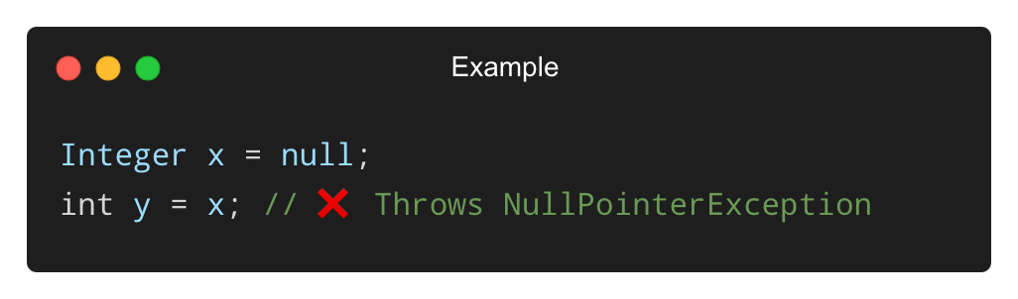
Common Pitfalls and Errors
❌ NullPointerException during unboxing:
✅ Always check for null before unboxing.

Slide 8
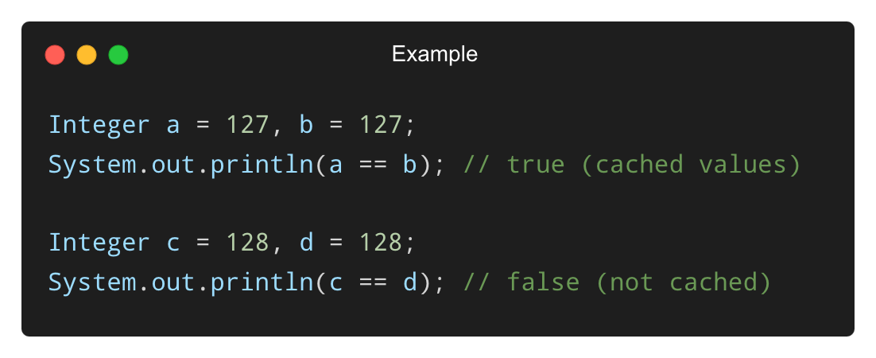
Common Pitfalls and Errors (Contd.)
❌ Using == for wrapper comparison:
✅ Use .equals() for comparing wrapper objects.

Slide 9
Best Practices with Autoboxing/Unboxing
✅ Use primitive types for performance-sensitive operations.
✅ Use wrapper classes when working with collections or generics.
✅ Check for null values before unboxing to avoid exceptions.
✅ Use .equals() instead of == for comparing wrapper objects.

Slide 10
THANK YOU

